Slide 1
EUROPE
TOP TEN

Slide 2
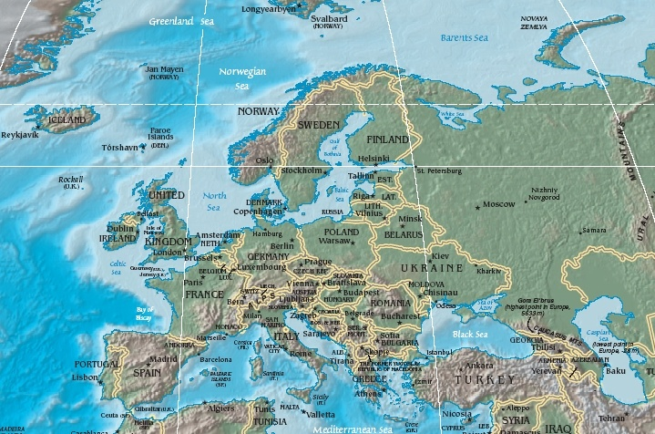
#1 – “A Peninsula of Peninsulas”

Slide 3
Northern Peninsulas
Scandinavian Peninsula – Norway & Sweden
Fjords – sea filled valleys carved out by glaciers
Jutland – northern peninsula opposite the Scandinavian Peninsula is major geographical feature of Denmark

Slide 4
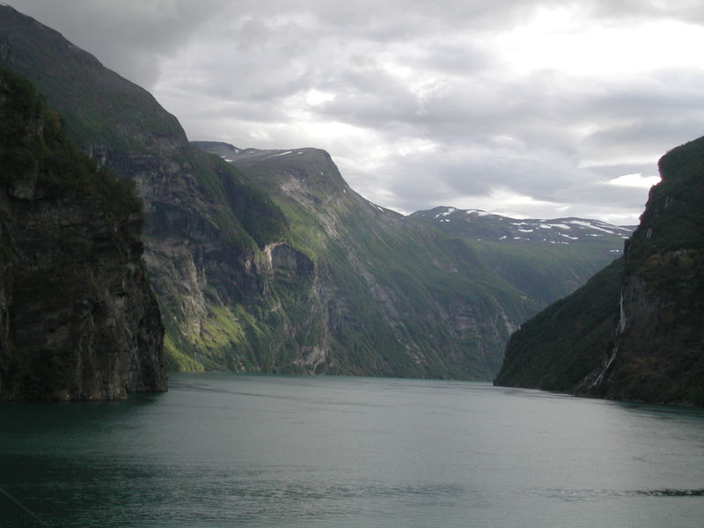
Fjords – Geirangerfjord in Norway

Slide 5
Southern Peninsulas
Iberian Peninsula – Spain and Portugal
Apennine Peninsula – Italy, shaped like a boot, has 4,700 miles of coastline
Balkan Peninsula – Albania, Bulgaria, Greece, Romania, mountainous so transportation is difficult

Slide 6
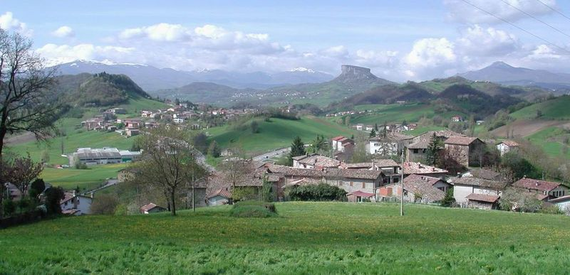
Apennine Peninsula

Slide 7
#2 - Islands
Atlantic Islands:
Iceland – “Land of Fire and Ice” (Volcanoes and glaciers exist side by side on the island)
British Isles – England, Scotland, Wales, Northern Ireland, & Ireland
Mediterranean Islands:
Balearic Islands (Spain)
Corsica (France)
Sardinia (Italy)
Sicily (Italy)
Malta

Slide 8
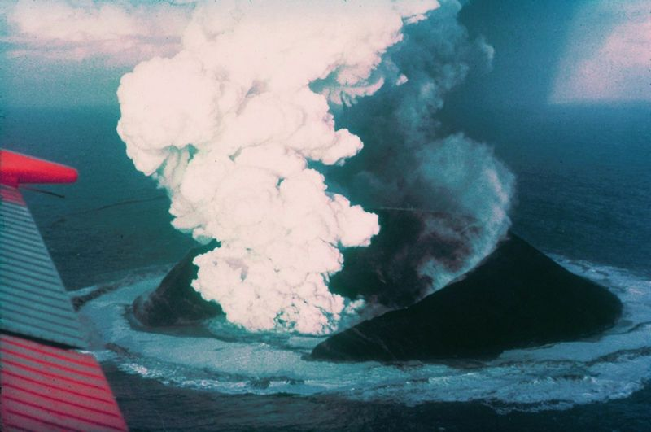
Iceland: A New Island Forms
Surtsey 16 days after the first eruption.

Slide 9
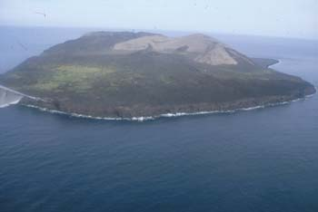
Iceland: A New Island Forms
Surtsey is a volcanic island off the southern coast of Iceland. It was formed in a volcanic eruption which began 130 meters below sea level, and reached the surface on 14 November 1963. The eruption may have started a few days earlier and lasted until 5 June 1967.

Slide 10
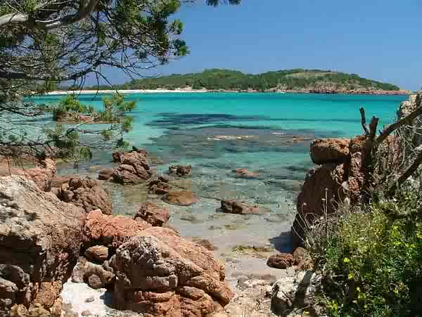
Corsica

Slide 11
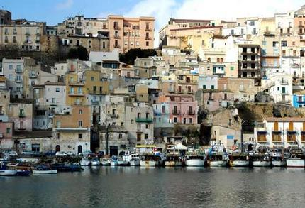
The port town of Sciacca, Sicily

Slide 12
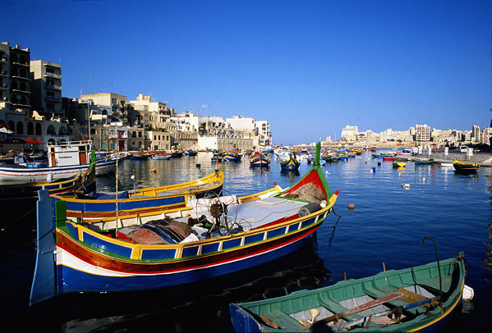
Malta

Slide 13
#3 - Mountains
Alps – arc across France, Italy, Germany, Switzerland, Austria, & the northern Balkan Peninsula, cut off Italy from the rest of Europe
Pyrenees Mountains - block off Spain & Portugal from the rest of Europe
Apennine Mountains – run like a spine down Italy
Balkan Mountains – block off the peninsula from the rest of Europe

Slide 14
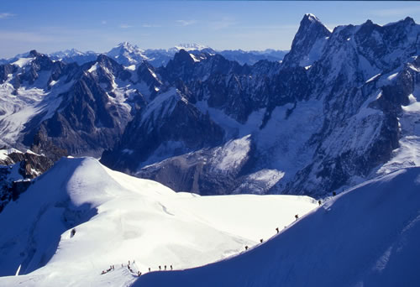
The Alps

Slide 15
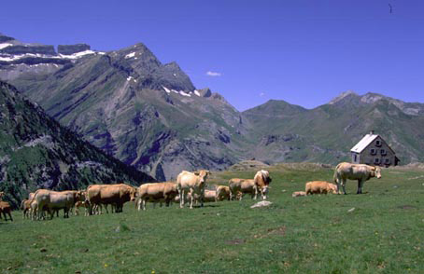
Pyrenees Mountains

Slide 16
#4 - Rivers
Rivers are important transportation routes to carry goods between the coastal harbors and the inland region
Danube River – 1,771 miles long, links Europeans to the Black Sea, touches 9 countries
Rhine River – flows 820 miles from the interior of Europe north to the North Sea

Slide 17
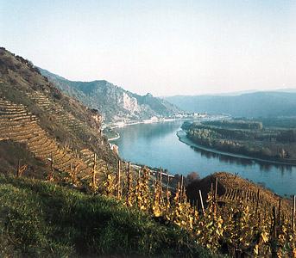
Danube River

Slide 18
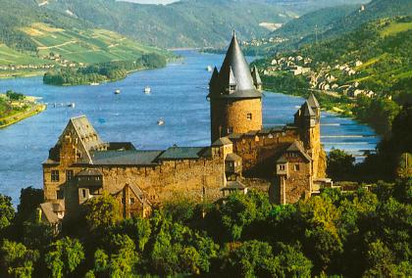
Rhine River

Slide 19
#5 – H/E Interaction - Polders
Polders: Land from the Sea
Dutch reclaimed land from the sea for their growing population
At least 40% of the Netherlands was once under the sea
Polders – reclaimed land

Slide 20
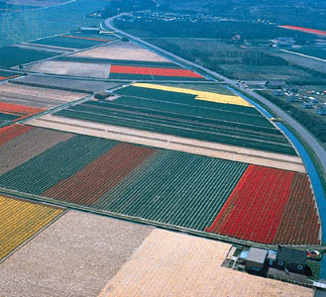
Flower cultivation in the polders of The Netherlands.

Slide 21
#6 – H/E Interaction – Venice
Venice’s Canals
City is made up of 120 islands & part of the mainland
Grand Canal, a broad waterway, flows between 2 of the largest islands
More than 150 canals that snake around and through the islands
Water pollution threatens Venice
Industrial waste, sewage, & saltwater are working to eat away the foundations of buildings
Floods also endanger the city

Slide 22
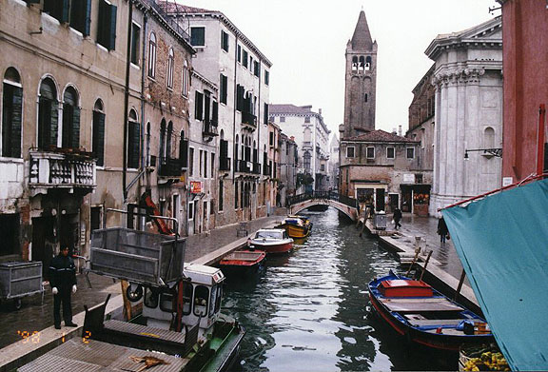
Venice

Slide 23
#7 - Europe Today
Europe is a multicultural continent.
More than 30 countries whose people speak more than 50 different languages.
Recent years have seen Europeans want to be unified.
Many countries belong to the European Union.

Slide 24
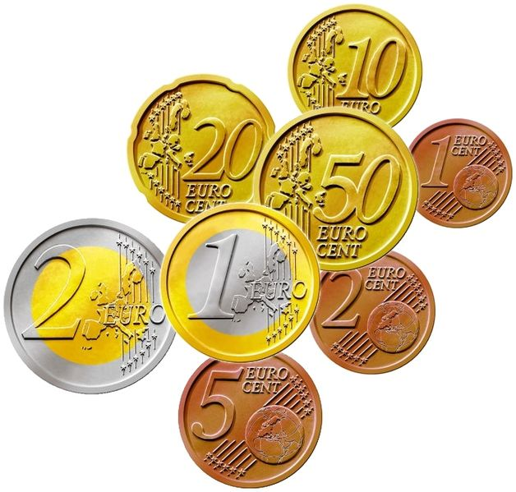
#8 - European Union
European Union – an economic unit forming a single market for their resources.
Member nations now have a single currency – the Euro.
Goods, services, workers, and money can now move more freely among the member countries.

Slide 25
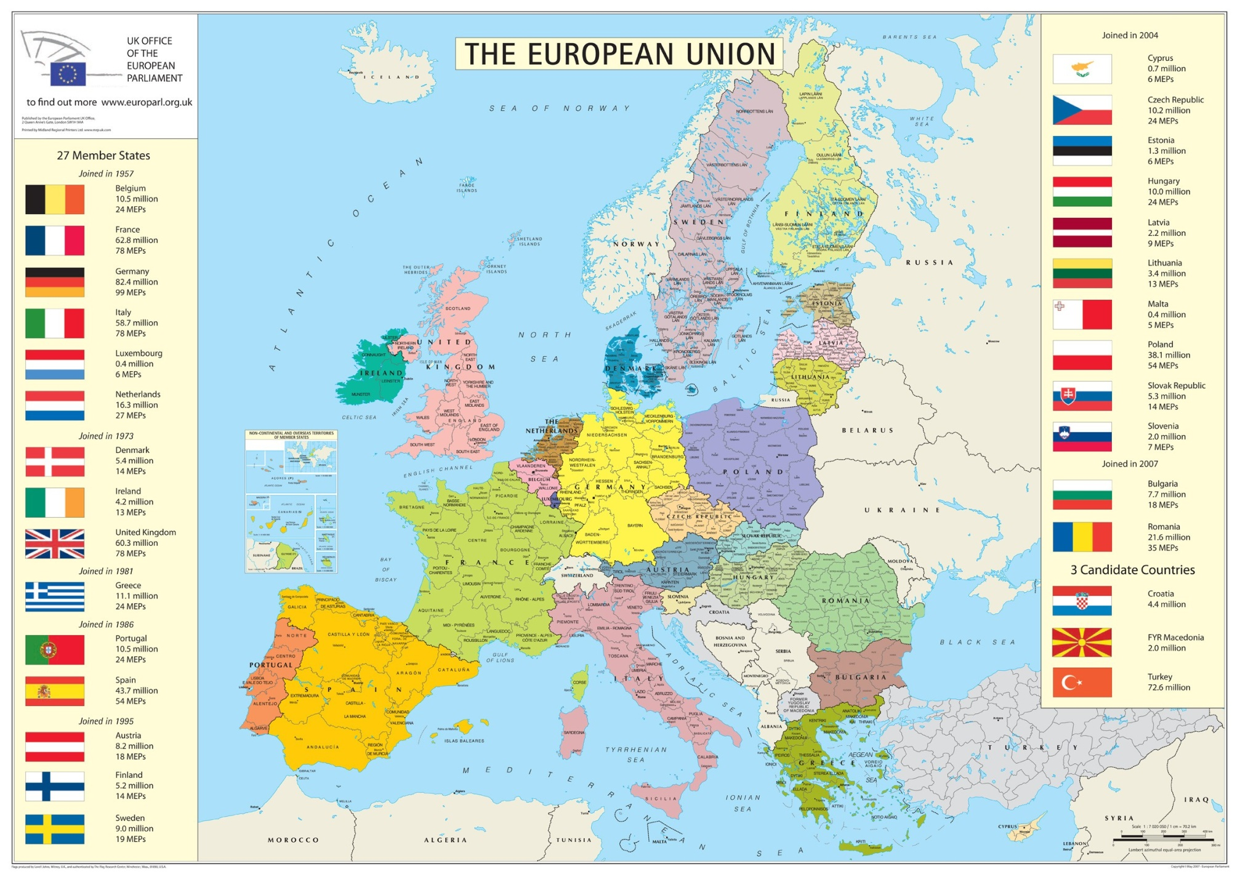
European Union

Slide 26
#9 - Population
Europe is smaller than any other continent except for Australia.
Only Asia is more densely populated.
Europe’s population is about 511 million

Slide 27
#9 – cont. (population)
Germany ranks as the most heavily populated nation in Europe with 82 million.
Vatican City is the smallest country of any country in the world with a population of around 1,000.
It is only 109 acres and important because it is the headquarters of the Roman Catholic church.

Slide 28
#10 - Religion
Religion has shaped European values.
Most of Europe’s Christians are Roman Catholic in southern Europe and in northern Europe they are Protestant.
Eastern Orthodox faith in Eastern Europe.

